Slide 1

Machine Learning in Context, Part 1
Time Series and Spatial Data
Yordan Darakchiev
Technical Trainer
yordan@softuni.bg

Slide 2
Sli.do
#softuni-ml-1

Slide 3
Table of Contents
Time series
Decomposition
Modelling
Forecasting
Spatial data
Exploring
KDE and kNN
Modelling

Slide 4
Time Series Analysis
Making sense of changing trends

Slide 5
Time Series
Functions which evolve over time
Applications
Weather reports
Medicine
Budgeting
Resource allocation
etc.
Process
Prepare the data
Find and apply a reasonable model
Use the model to forecast future values
Note: All discussed algorithms assume regular reporting

Slide 6
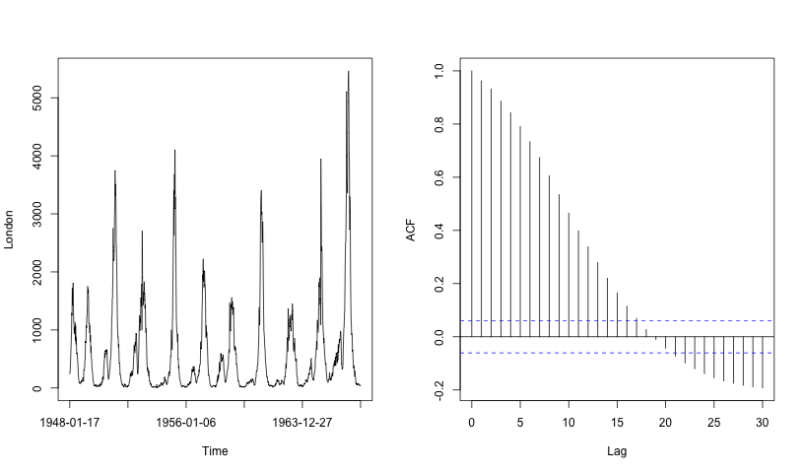
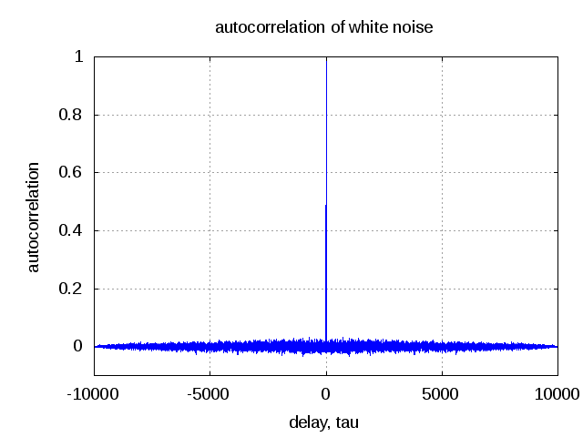
Time Series and Noise
Time series have structure
Even if that's not visible at first glance
The values can be predicted
Noise is truly random and can't be predicted
Autocorrelation – shows how a data point is correlated to a previous data point

Slide 7
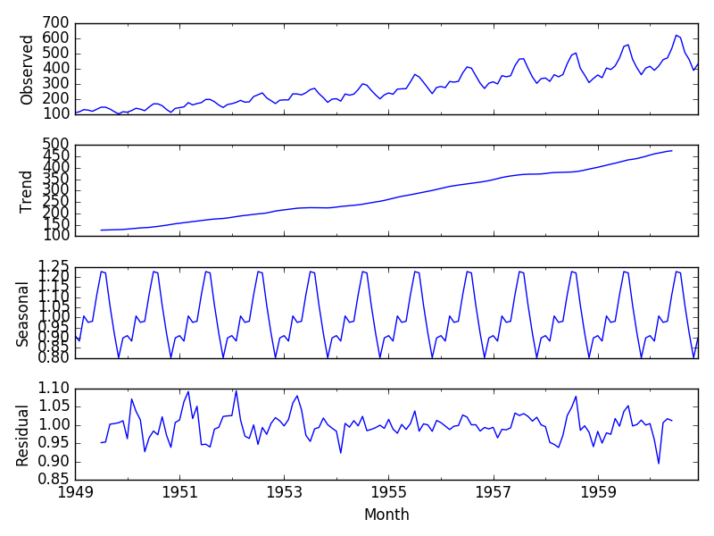
Time Series Decomposition
Three main components
Overall trend
Seasonal (periodic) component
Random (irregular, residual) component
Time series can be additive or multiplicative
Additive – seasonal variation is relatively constant
Multiplicative – seasonal variation increases over time

Slide 8
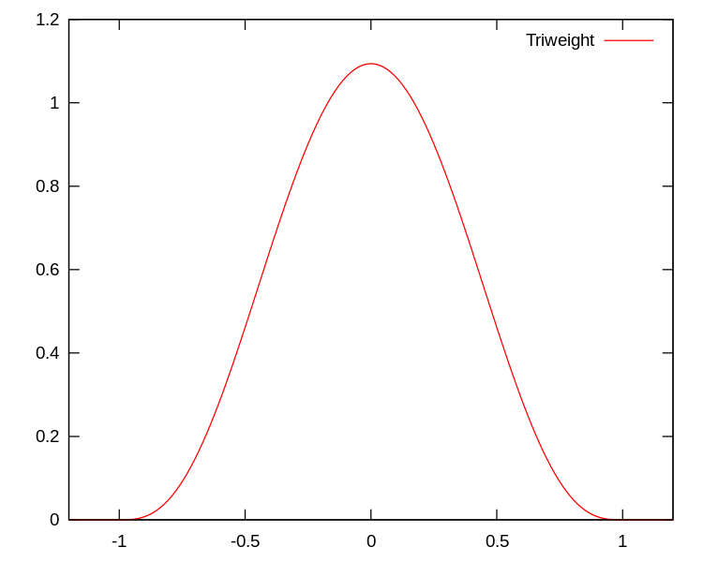
Getting the Trend – LOESS Regression
LOESS – local regression
Gives us an estimate of a small region of the data
Can be used for scatterplot smoothing
Algorithm
Define a window width m
Subject to optimization
Too small = too little trend, too big residuals
For each data point, assign weights to the m nearest points
Usually normalized triweight function
Third-degree function
Gives a lot of weight near the central (current) point
Normalized to equal 0 outside of the interval m
Do polynomial regression (e.g. quadratic) using the weights

Slide 9
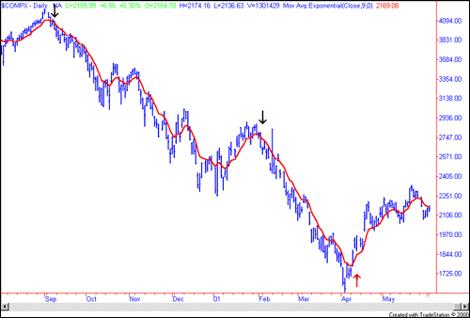
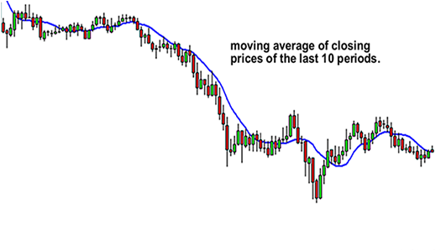
Getting the Trend – Moving Average
Another smoothing method
Algorithm
Start with the signal period T
Downside – we have to know the period
Average the first T points to get a starting estimate
Move by one point and average points [2; T + 1], etc.
Subtract the moving average from the observed data
If there's still some trend remaining, repeat the process (with another period)
Until the residual is stationary: mean and variance don't change over time; no (significant) autocorrelation
Trend = sum all moving averages
Residual = data – trend

Slide 10
STL
Seasonal Decomposition of Time Series by LOESS
A method to get the time series decomposition
LOESS – better for "coarser" structure, MA – better for "finer" structure
Quite complex mathematics
We'll just review the basics
Algorithm (X = observed data)
Use LOESS to find the general trend T
Use moving average smoothing to find additional trend C in X – T
Seasonal component S = X – T – C
Smooth the total trend X – S with LOESS to get a better trend estimate V
Remainder R = X – S – V
Note: For multiplicative time series use * and / instead of + and –

Slide 11
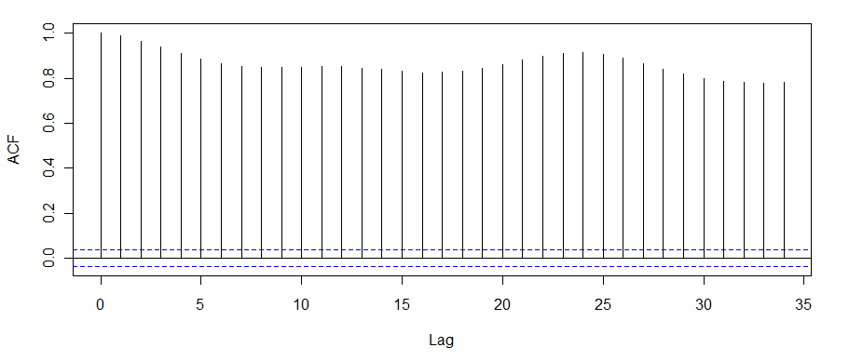
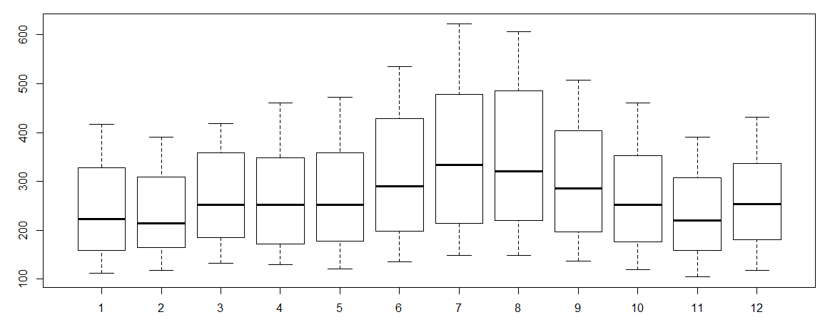
Stationary Data
Data which doesn't vary significantly with time
Parameters are nearly constant
Constant mean and variance
Constant autocorrelation (correlation is not a function of time)
Autocorrelation function
Parameter: "lag" – time difference
Higher (in absolute value) = better
Examination – boxplots, autocorrelation plots
Boxplots should look nearly identical
No trends (besides random variations)
Autocorrelation plots shouldn't have many significant values

Slide 12
Modelling Time Series
Now that we've decomposed the data, we want to create a regression model
To be able to forecast new data
Two main kinds of models
Moving average models (MA)
Autoregression models (AR)
Collectively known as ARMA models

Slide 13
Time Series Models
Moving average models
Random event => noise
Each data point is determined by the current noise and previous noises
Scaled by some coefficients:
Order: number of data points (e.g. order 2)
Example:
Always stationary
Examination: autocorrelation plots
The ACF drops sharply
Autoregressive models
Each data point is determined by current noise and previous data points
Scaled by some coefficients:
Examination: partial autocorrelation plots (the partial ACF – PACF drops sharply)

Slide 14
Lab: Time Series Generation
Generate many (e.g. 10 000) random numbers
Gaussian noise with mean 0 and standard deviation 1
Create a moving average model
Use
Create an autoregression model
Use
For each generated data
Plot and examine the data
Generate ACF and PACF plots
Use the statsmodels.tsa library
from statsmodels import tsa
tsa.statstools.acf(data)
tsa.statstools.pacf(data)

Slide 15
Lab: ARMA Models
Use various AR and MA models to fit a time series
Use the cadairydata.csv dataset (dairy production)
First, separate the trend and seasonal components
Try to fit MA models of degrees 2, 3, 4 and 5
Print the summary of the coefficients and their errors
If an error is >= coefficient, the degree is too large
Which is the best degree?
Try to fit AR models (degrees 1, 2 and 3)
Try to fit an ARMA model
Combination of AR of order p and MA of order q
Observe which models do the best explanatory work
Try forecasting future values using the generated models
This tutorial might be helpful

Slide 16

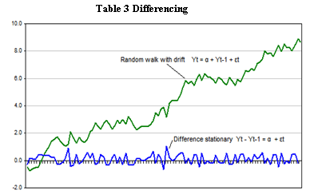
Differencing and ARIMA
If the data has a clear trend (i.e. is not stationary), we can obtain stationary data by taking the derivative
"Discrete derivative": difference series
Linear trend => constant
E.g. random walk
Quadratic trend => linear => constant; etc.
In general: polynomial trend of degree d => d – 1 times
ARIMA(p, d, q): Autoregressive Integrated Moving Average
AR(p) + MA(q) + I(d)

Slide 17
Spatial Data Analysis
Making sense of space

Slide 18
Spatial Data
Functions of position
Can be used for regression or classification
Position doesn't need to be geographical, e.g. image coordinates
We're usually interested in densities (since events tend to clump together)
Spatial data is almost never distributed uniformly
Applications
Finding where to open a new shop to optimize for traffic
Finding where to place more police force based on crime density
Uncovering how a particular place affects a process
E.g. how proximity to a river affects pollution
Like time series, we need some preprocessing

Slide 19
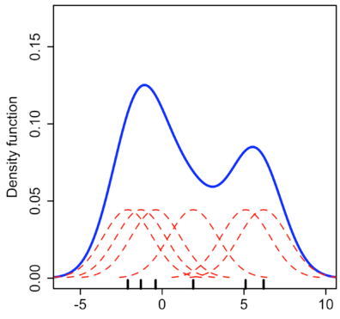
Kernel Density Estimation (KDE)
We could plot data points directly on a map
But we want a continuous "density" measure
In some cases, k-nearest neighbors (kNN) works as well
Algorithm
Surround each point with a function (kernel)
E.g. Gaussian with given standard deviation (subject to tuning)
Sum all kernels to get a total result
Useful for 1D, generalizes easily
Just use a multi-dimensional kernel
Produces a smooth function, representative of the data density
Tutorials: seaborn, scikit-learn

Slide 20



Modelling Spatial Processes
Given a region B and a number of events n, how often does number of events in B equal n?
Depends on size of B, number n and rate of events
Spatial Poisson process:
Mean and variance equal to
Homogenous: the parameter is constant everywhere
Inhomogenous: depends on the coordinates
Therefore, we need to integrate
How to choose the function of coordinates? Depends on the process
E.g. linear function, polynomial, KDE, proximity to an object, etc.

Slide 21




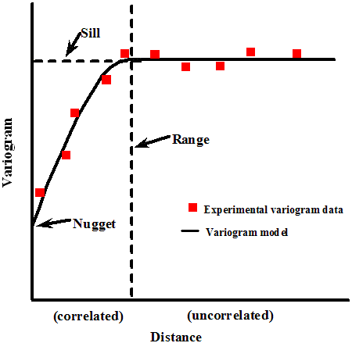
Variograms
Graphical representation of variability in data
Given two points , and their labels , , calculate the differences in labels
Meaning: How much does the label change at the given distance?
Note: In the variogram formula, the distance is halved
Semivariogram: the same thing, without the scale factor 0.5
Sill – the top part
The label stays the same with increasing distance
Interpretation
"Increasing" part covers a large distance => the data changes very smoothly (and vice versa)

Slide 22
Spatial Regression (Kriging)
The variogram estimates the spatial covariance function among points
Using the variogram, we can run regression
Known as spatial regression, kriging or Gaussian process
The model assumes a Gaussian data generating process
As a result, we obtain a model of the data
We can use this model to predict values

Slide 23
Lab: Spatial Regression
Obtain a dataset of spatial data
Explore and plot the data
Exploratory data analysis is essential
Try to find relationships and patterns beforehand
Try modelling the data with kNN and / or KDE
Score the model and report the results
Perform kriging
You may need to install a package
Also have a look at this tutorial
Compare the results and select the better model

Slide 24
Summary
Time series
Decomposition
Modelling
Forecasting
Spatial data
Exploring
KDE and kNN
Modelling

